Slide 1
Seminar Library Management System
Name Roll
Sujit Bisoi 15201220058
Koulick Ghosh 15201220036
Arka Prabha Majumdar 15201220138
Swapnadeep Kundu 15201220009

Slide 2
Introduction
We are delighted to present a seminar on library management systems, focusing on the latest advancements and best practices in the field. This seminar aims to address the increasing demand for efficient and user-friendly library systems. We will explore innovative technologies and strategies that streamline library operations, enhance user experience, and optimize resource management. Join us to discover cutting-edge solutions for cataloging, circulation, acquisitions, and digital asset management. Learn how to improve access to information, facilitate efficient search capabilities, and provide personalized services to library users. This seminar is a valuable opportunity to network with industry professionals, exchange knowledge, and stay up-to-date with the evolving landscape of library management.

Slide 3
Why seminar library management system ?
1. Increasing demand for efficient library management: Libraries play a crucial role in providing access to information and resources. As the demand for efficient management of library operations grows, there is a need to explore advanced systems that can streamline processes and improve user experience.
2. Technological advancements: The rapid advancement of technology offers new opportunities to revolutionize library management. By choosing this project topic, we aim to explore and discuss the latest technological tools and innovations that can optimize library operations and enhance services.
3. User-centric approach: A well-designed library management system can greatly benefit library users by providing easy access to resources, efficient search capabilities, and personalized services. By focusing on this topic, we aim to improve the user experience and satisfaction within library settings.
4. Resource optimization: Libraries often face challenges in managing their collections, budgets, and acquisitions. The project topic of a library management system allows us to delve into strategies and solutions that can optimize resource management, including effective cataloging, inventory management, and budget allocation.

Slide 4
Main Objective of the application
1. To explore the latest advancements in library management systems: The seminar aims to provide insights into the newest technologies, tools, and software solutions that can enhance the efficiency and effectiveness of library operations.
2. To discuss best practices for improving user experience: The seminar will focus on strategies and approaches that can enhance user satisfaction by providing easy access to resources, personalized services, and seamless navigation within the library system.
3. To optimize resource management: The seminar will address methods for efficient cataloging, inventory management, budget allocation, and acquisitions, allowing libraries to maximize their resources and provide a wide range of quality materials to users.
4. To foster knowledge sharing and collaboration: The seminar will provide a platform for professionals in the library field to exchange ideas, experiences, and insights. Participants can learn from each other's successes and challenges, ultimately promoting collaboration and professional development within the library community.

Slide 5
Feasibility Study
A feasibility study is essential in library management systems to determine the practicality and viability of implementing such a system. It helps assess factors such as cost, resources, time, and technical requirements. It ensures informed decision-making, identifies potential challenges, and provides a basis for planning and implementation, ultimately leading to an effective and successful library management system.
Technical feasibility-
study required in library management system. A technical feasibility study is necessary in a library management system to evaluate if the system can be implemented using the available technology infrastructure, considering factors such as hardware, software, network capabilities, and compatibility with existing systems.
Economic feasibility-
An economic feasibility study is necessary in a library management system to assess the financial viability and benefits of implementing the system, considering costs, and potential cost savings or revenue generation.
Operational feasibility-
An operational feasibility study is necessary in a library management system to determine if the system can be effectively integrated into the library's operations, considering factors such as staff capabilities, workflow, and user acceptance. Social feasibility study required in library management system.
Social feasibility-
A social feasibility study is not a commonly emphasized aspect of a library management system. The system can help ensure that the system enhances social interactions, inclusivity, and overall user experience.

Slide 6
System Requirement Specification
FUNCTIONAL REQUIREMENTS:
Improved Efficiency: The system automates various library processes, reducing manual effort and saving time for librarians and users. It streamlines tasks like cataloging, circulation, and inventory management, leading to increased operational efficiency.
Enhanced User Experience: Users can easily search for and access resources, place requests, and renew items through the online catalog. The system provides personalized recommendations and notifications, improving the overall user experience.
Accurate Resource Tracking: With the system's tracking capabilities, librarians can accurately monitor the movement of library materials, reducing loss, misplacement, and theft. This ensures the availability of resources when needed.
Effective Resource Utilization: The system helps optimize resource allocation by providing insights into the usage patterns, popularity of resources, and user preferences. Libraries can make informed decisions regarding collection development and resource acquisition.
Data Management and Analysis: The system captures and stores valuable data on library operations, users, and resources. Librarians can analyze this data to gain insights, identify trends, and make informed decisions for improving library services and resource management.

Slide 7
System Requirement Specification
NON FUNCTIONAL REQUIREMENTS:
Physical Security: While the library management system assists in tracking and managing resources, it does not directly address physical security measures such as surveillance cameras, alarms, or access control systems.
Interlibrary Loan Integration: Some library management systems may not have built-in integration with interlibrary loan networks, requiring additional manual processes for requesting and obtaining materials from other libraries.
Collection Development: The system may not include features specifically designed for collection development, such as analyzing user needs and preferences, or suggesting new acquisitions based on emerging trends or curriculum requirements.
Digital Rights Management: Depending on the system, it may not provide comprehensive digital rights management features, such as controlling access to copyrighted e-resources or managing licenses and restrictions for digital content.

Slide 8
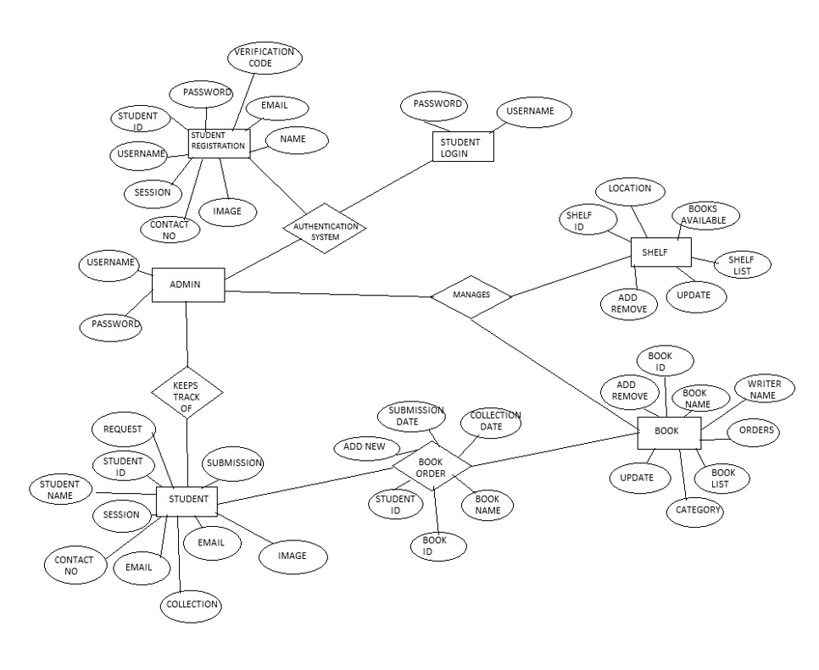
ERD

Slide 9
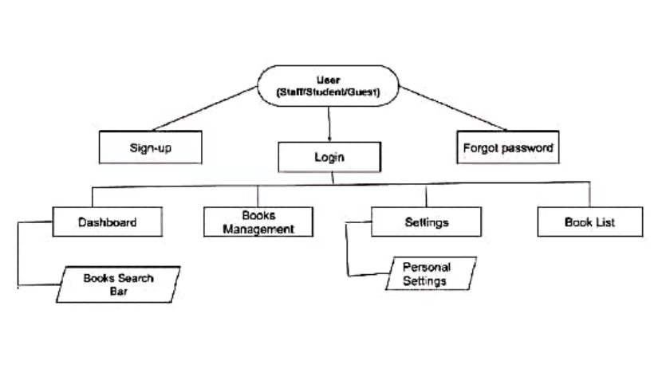
DFD user

Slide 10
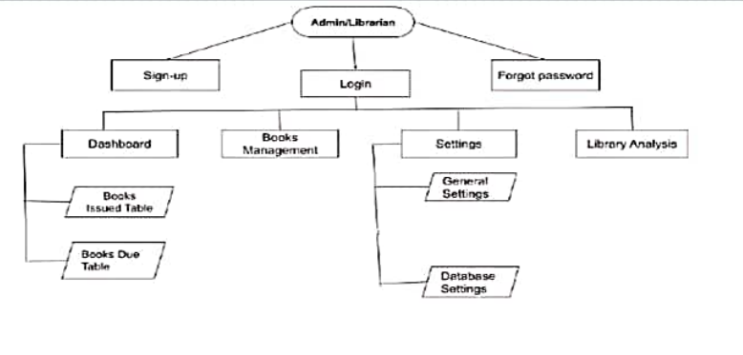
DFD ADMIN

Slide 11
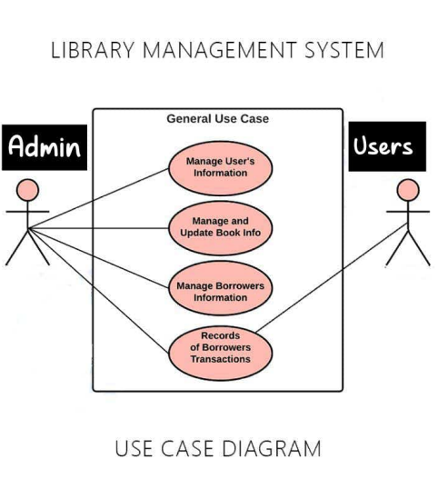
Use case diagram

Slide 12
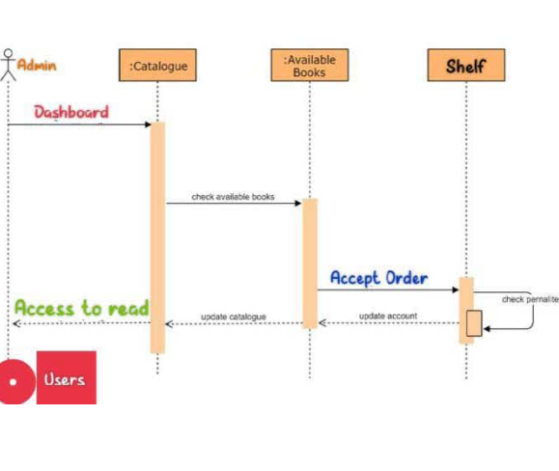
sequence diagram

Slide 13
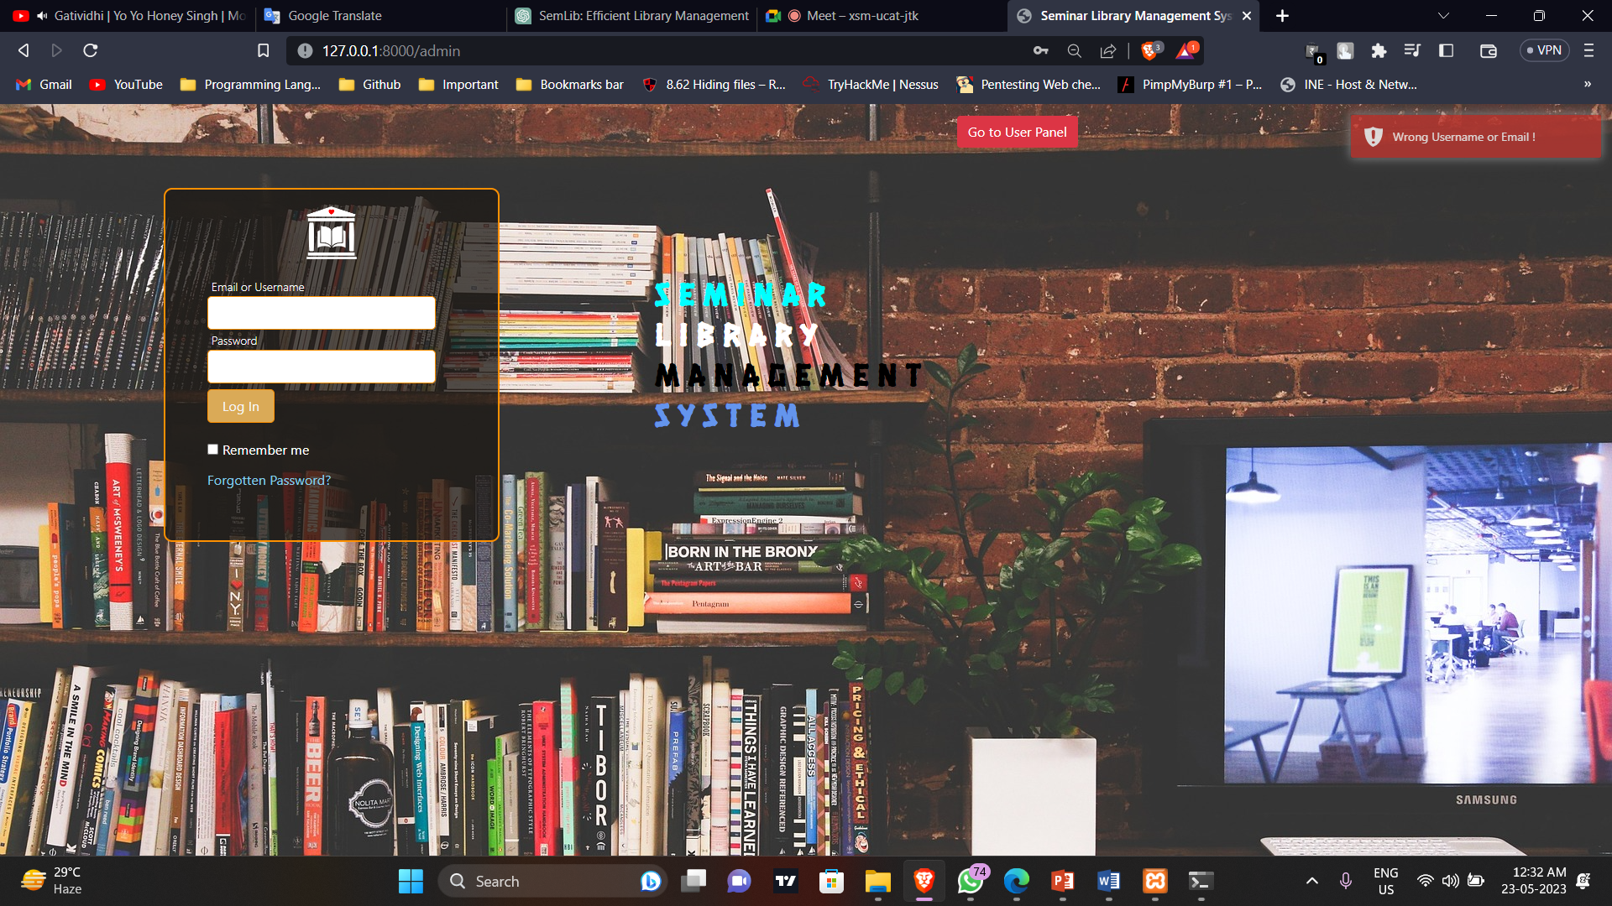
Testing
Testing Case 1 :-
Entering wrong credential for admin login it show us “Wrong Username and password” that’s means email and password validation working fine.

Slide 14
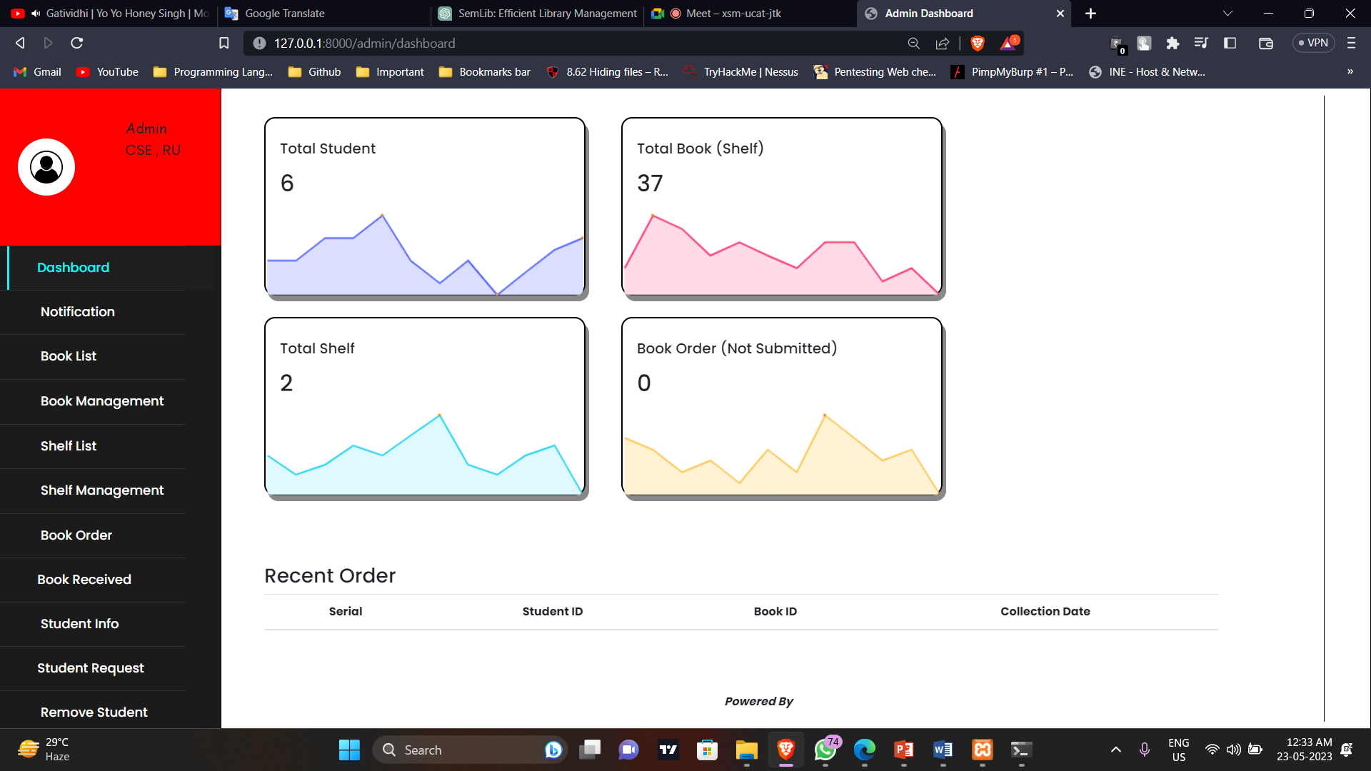
Test Case 2 :-
After entering correct password for admin we are entering as admin account

Slide 15
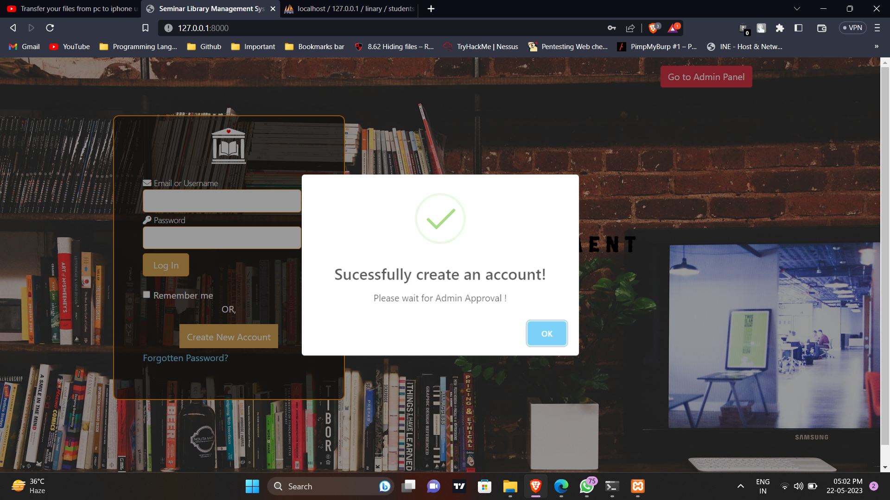
Test Case 3 :-
After registering a new user can’t log in with out admin permission and the validation working fine.

Slide 16
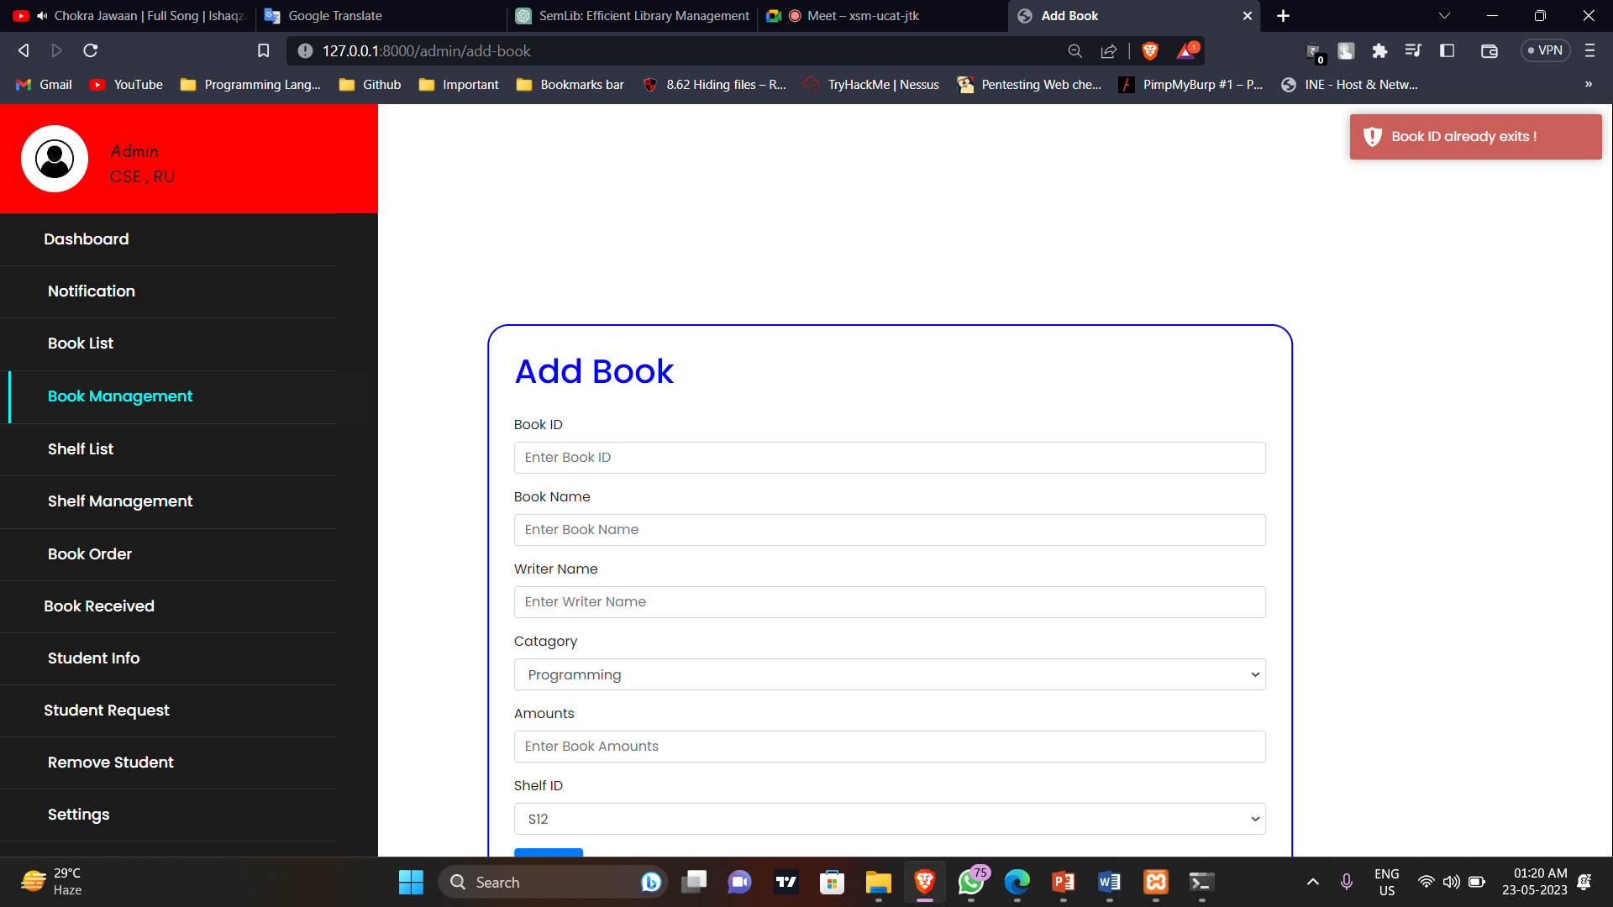
Test Case 4 :-
If admin want’s to add book but the book id is wrong. So the book is not added.

Slide 17
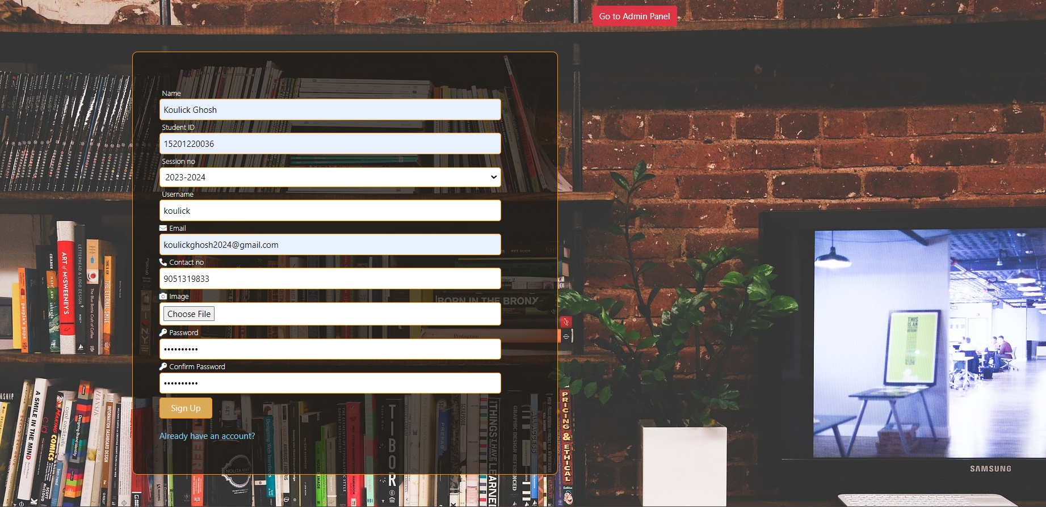
First student need to register his self

Slide 18
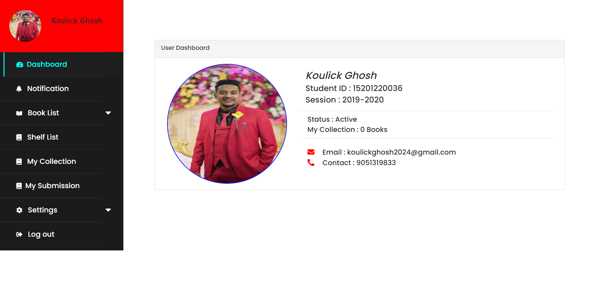
After login students go to the dashboard, here Students can see the book list that is in the library, the shelf list and location, and in my submission tab students see the submission details. Students also change their password.

Slide 19
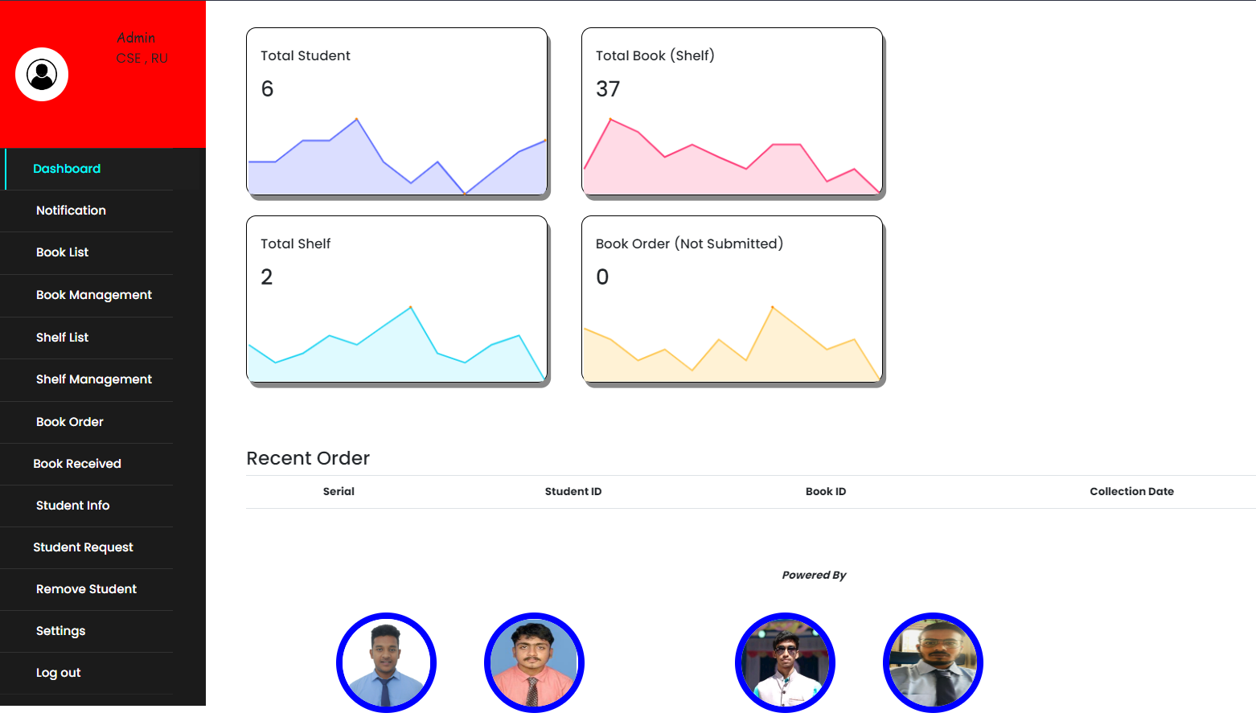
After the admin login goes to the admin dashboard, here admin sees the book list and the admin can add, update and remove books. Admin can manage shelf also admin can see book order and book received. When a new student registers his self admin has to accept them otherwise student can’t log in. Admin can also remove students.

Slide 20
Limitation and scope of the project
Scope
The future scope of this project is very broad few of them are:
There is ample scope of enhancement and adding functionalities to this system. This system can be extended to send email for verification . Session Timeout can also be implemented to increase more security.
Limitation
There is no centralized database maintenance.
There is no easy access to records of people seeking work in particular.
Students can’t get any email notification of any new scheduled class, notes uploaded notes or updates.
Lastly, Communication with teachers is difficult for students when they are in a group. We will add a “Chat Box” function in future to overcome this problem also.

